Slide 1

Practical Hacking Exercise

Slide 2
Agenda
How to setup up OWASP tools
Web App Attack Examples
Authentication
Session management
Access controls
Client controls
Back-end interpreters
Attacking the user

Slide 3
Legality
Computer Misuse Act 1990
Issue of ‘consent’
DON’T target anything for which you do not have explicit written consent
DO try this at home BUT on your own network / virtual machine (e.g. using OWASP projects)
Notes:
Question – what counts as consent to perform a security assessment?

Slide 4
Setting Up Your Tools
We will use OWASP projects (of course).
We need
a browser -> “Mantra”
an intercepting proxy -> “ZAP”,
and some target websites -> “Broken Web Apps”.
URLs will be supplied at the end

Slide 5
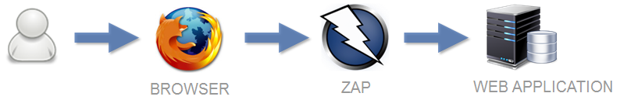
Setting Up Your Tools
An intercepting proxy works like below:
Using Mantra and ZAP, we intercept and manipulate traffic in both browser requests and web server responses to forge attacks.
Notes:
Question – does everybody understand the concept of an intercepting proxy?

Slide 6
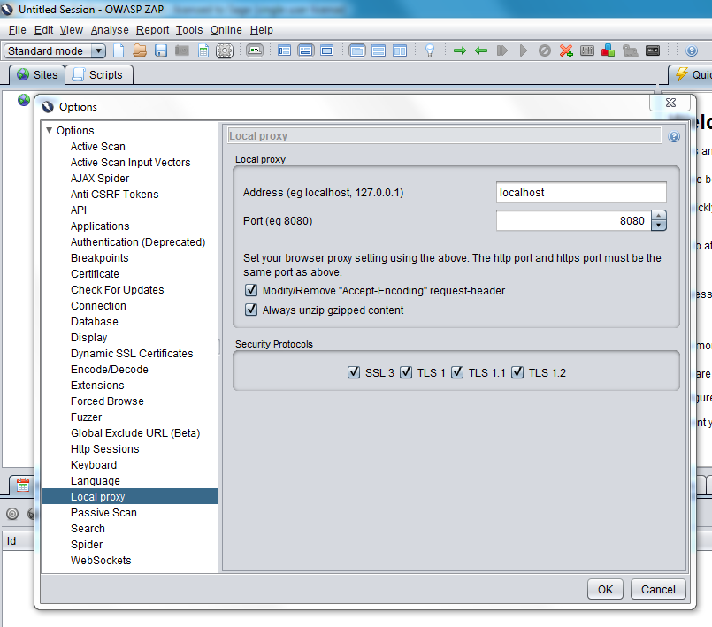
Configure ZAP
Notes:
Open ZAP and show this.
Explain that we will also user Burp (free edition) for some demos, which can be configured in a similar way.

Slide 7
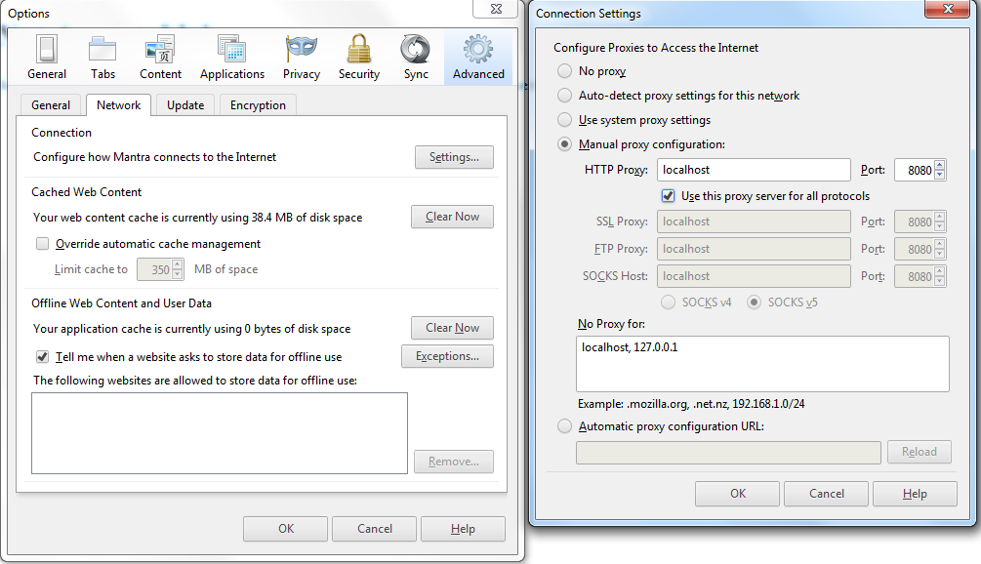
Configure Mantra
Notes:
Open Mantra and show this.

Slide 8
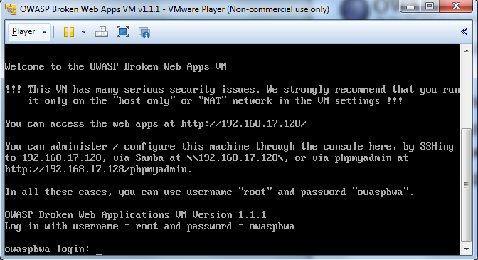
Configure Broken Web Applications
Notes:
Open Broken Web Apps and show this.

Slide 9
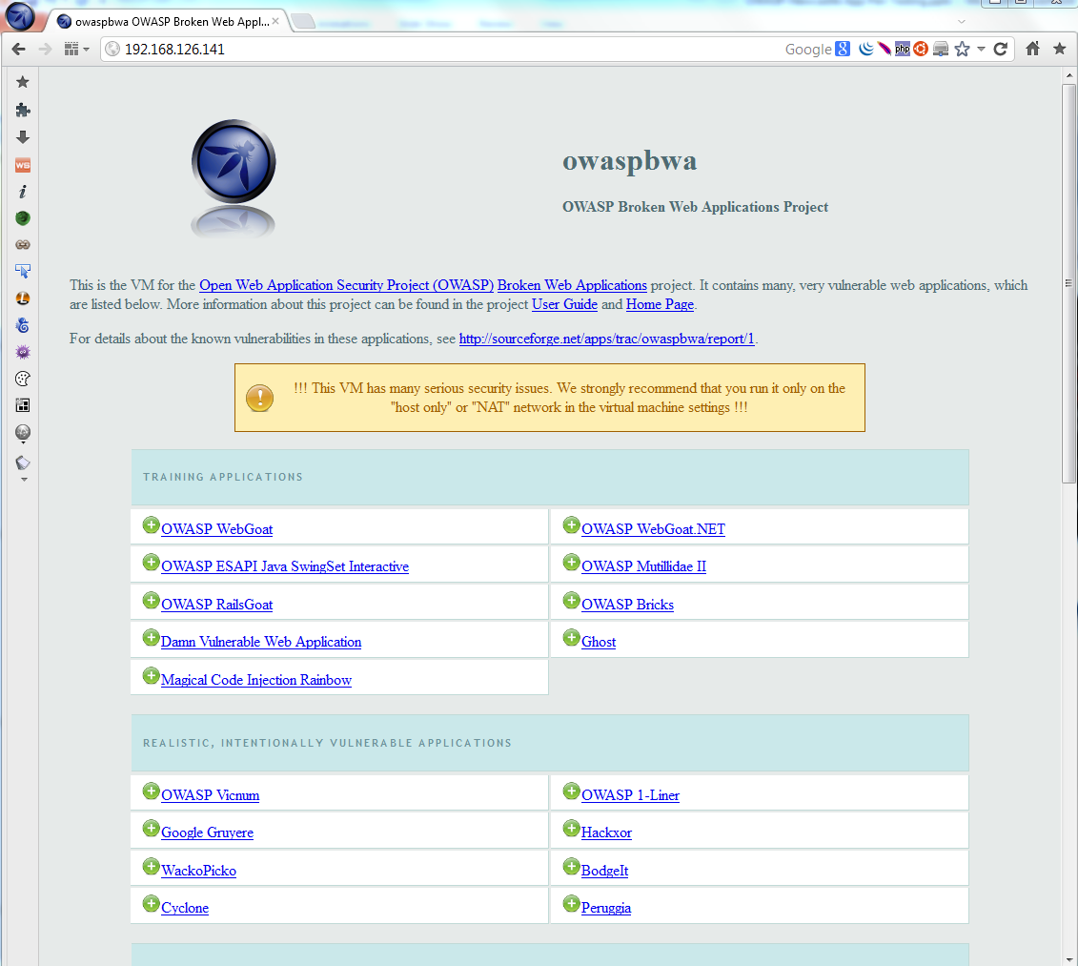
Broken Web Applications

Slide 10

1. Authentication
The authentication of an application is a critical line of defence.
If authentication fails, the application fails
Primary target for attackers

Slide 11
Example Attacks
Default / weak passwords
User enumeration
Password hints
Brute force password guessing
Default pages
Robots.txt
Guessable admin pages (security through obscurity)
Notes:
Default Passwords:
Google “default passwords”
Weak Passwords:
OrangeHRM - login with admin/admin
User enumeration at login:
Getboo
User enumeration at user registration:
Getboo
User enumeration at forgotten password:
Joomla
Password hint weakness:
Getboo – create new user / use account recovery
Brute force password guessing:
Wordpress – introduce ZAP Fuzzer. Do a failed login as admin then user ZAP fuzzer
Default pages:
Mutillidae – phpinfo.php
Robots.txt directory leakage:
Mutillidae – robots.txt
Guessable admin page (note: no authentication needed):
BodgeIt Store – admin.jsp

Slide 12
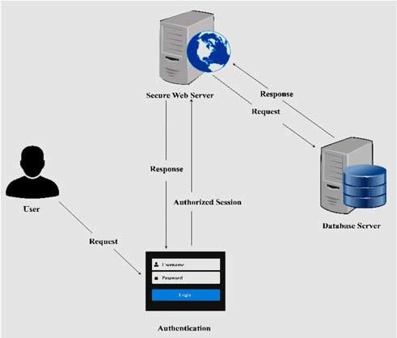
2. Session Management
Session management is fundamental to security as it uniquely identifies users.
Enables assurance of user identity beyond login.
Session management is a prime target for attacks.

Slide 13
Example Attacks
Cookie meaning
Decoding cookie values
Cookie pseudo-randomness
The ‘secure’ flag
Session timeouts
Duplicate logins
Session fixation
Notes:
Cookie meaning:
OrangeHRM – Introduce ZAP Re-Send. Login as admin then use ZAP Re-send to demo how removing the cookie is meaningful
Wordpress – Introduce Burp Repeater. Login via 2 separate browsers both going through different proxies (user/user, admin/admin), two cookies are set, substitute cookie values in Repeater
Decoding:
Joomla – Introduce ZAP Decoder. Show how a cookie response might be captured and decoded using burp decoder and also in ZAP (login with author/author); this won’t decode but principle is there to see
Sample Session token - dXNlcj1ib2I7YXBwPWFkbWluO2RhdGU9MTAvMDkvMTQ – Base64
Cookie Entropy:
Web calendar – Introduce Burp Sequencer. Login as user/user, send the login POST request to sequencer and demonstrate an analysis
Secure Flag:
Mutillidae over SSL – clear cookies, show how a cookie is set without the secure flag by capturing a response
Timeouts:
Pick a previously logged in example in Burp and attempt to replay a request (e.g. you should have logged into Wordpress a while back)
Duplicate Logins:
Wordpress – show how you can login as user/user from two separate browsers and proxies
Session Fixation:
OrangeHRM – clear cookies, capture PHPSESSID before login, change it, show it was accepted, and then login as admin/admin to show that it was also not changed after login

Slide 14
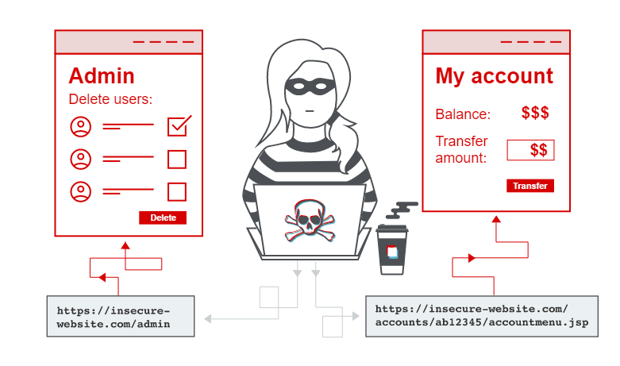
3. Access Controls
Access controls check authorisation to do something.
Defective access controls
allow a user to perform an action that should not be allowed.
account for a significant proportion of web application issues.

Slide 15
Example Attacks
Vertical privilege escalation
Horizontal privilege escalation
Forced browsing
Notes:
Vertical privilege escalation:
BodgeIt Store – guess admin.jsp
Vertical privilege escalation:
OrangeHRM – observe admin tab that a normal user won’t see, show how to request it as non-admin user
Vertical privilege escalation:
Mutillidae – web server allows access to passwd file here http://192.168.126.141/mutillidae/index.php?page=source-viewer.php if you intercept the request and change the file name to /../../etc/passwd
Horizontal privilege escalation:
Wordpress – attempt if you login as user/user, try to change the password for the admin user (guessing UID=1); doesn’t work but demonstrates how to attack this
Horizontal privilege escalation:
AppSense – login as foo / foo, add friend, observe ID and access that user’s ID.
Forced Browsing (ZAP):
BodgeIt Store – Introduce ZAP Forced Browsing via Attack -> Forced Browse Directory

Slide 16
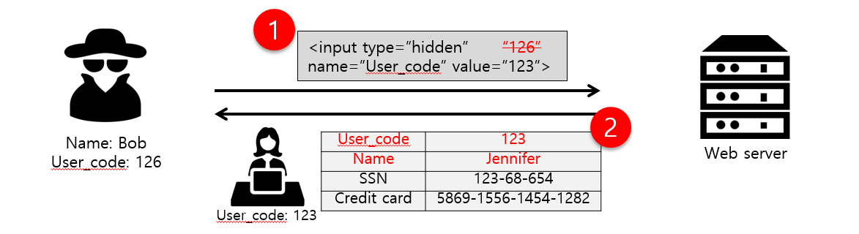
4. Client Controls
Applications pass important data to the client, read it back and then process it on the server.
valuable source of attacks due to the various techniques that can be used to achieve it.
all data sent from the client can be modified; it is outside our control.
Visit: https://infosecwriteups.com/what-is-parameter-tampering-5b1beb12c5ba

Slide 17
Example Attacks
User Agent manipulation
JavaScript controls bypass
Hidden form fields
Notes:
User Agent manipulation:
Mutillidae – Introduce user agent manipulation via Burp Match & Replace, and Mantra Tools -> Application Auditing -> User Agents
Show how you practice on http://192.168.126.141/mutillidae/index.php?page=user-agent-impersonation.php
Mistake to use as access control, as client controls this
JavaScript Input length Bypass:
Mutillidae – Introduce Burp response modification. JavaScript input length bypass at http://192.168.126.141/mutillidae/index.php?page=login.php, show the input field length limits then show how you can set burp to ‘remove input field length limits’ or simply catch a valid response and edit the values in the proxy
Hidden Form Fields:
BodgeIt Store – Hidden form fields: register an account, login then browse to http://192.168.126.141/bodgeit/product.jsp?prodid=26, then set burp to unhide hidden form fields, explain that hidden form fields can be used to affect pricing

Slide 18
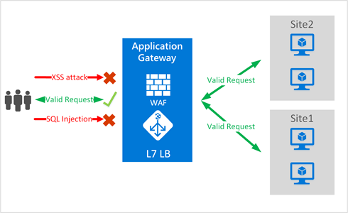
5. Back-end Interpreters
Web apps can interact with back-end interpreters such as databases or XML parsers.
user input is captured as variables which result in for example an SQL database query.
malicious injected syntax can be used to taint code that “breaks out” of the intended purpose to implement arbitrary commands.

Slide 19
Example Attacks
SQL injection detection
SQL injection login bypass
SQLMAP
Notes:
SQL injection detection:
BodgeIt Store – admin’, then admin’’ - observe how in the login field a single tick causes a system error in the top left, whereas two ticks clear it
Trivial SQL injection:
Peruggia - login can be bypassed with user: admin ‘ or 1=1--<space at end> password: anything
http://192.168.126.141/peruggia/index.php?action=comment&pic_id=2%20union%20all%20select%201,2,3,@@version
SQLMAP:
Mutillidae - sqlmap -u http://192.168.126.141/mutillidae/index.php?page=login.php --data="username=username&password=password&login-php-submit-button=Login" --passwords –flush
Y – N – Defaults…

Slide 20
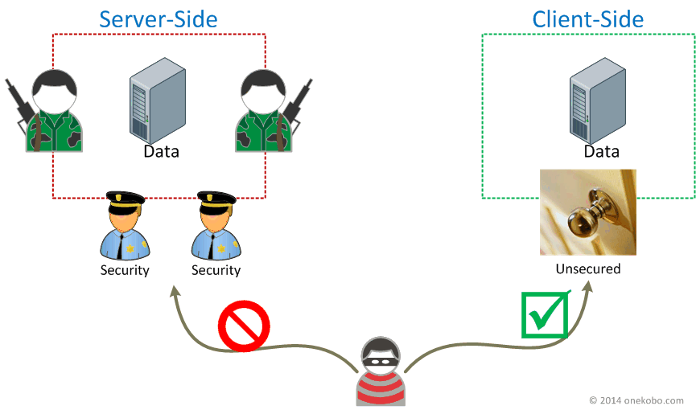
6. Attacking the Client
Recent shift in emphasis from server-side flaws to client-side flaws.
server-side flaws are now better understood and less prevalent.
attackers now look to exploit users by means of client-based flaws.

Slide 21
Example Attacks
Reflected XSS
Stored XSS
CSRF
Notes:
Reflected XSS:
Simple ASP.Net Forms - http://192.168.126.141/mono/simple-reflected-xss.aspx
Reflected XSS:
GTD-PHP - Go to Lists -> Checklists, Check List title is vulnerable at http://owaspbwa/gtd-php/checklistReport.php?checklistId=2&checklistTitle=<script>alert('xss')</script>
Stored XSS:
DVWA - Go to DVWA and Stored XSS section, login as user/user, add stored XSS to show document.cookie, verify, then logout and login as admin/admin for admin session hijack
CSRF:
Bodge It – login with test@thebodgeitstore.com/password, send to repeater, change request method.
Explain that this could be embedded in a blog website, fed via instant messaging or hidden as an image in an HTML email.

Slide 22
Links for a Home Test Lab
Web Browser - OWASP Mantra
https://www.owasp.org/index.php/OWASP_Mantra_-_Security_Framework
Intercepting Proxy - OWASP Zed Attack Proxy
https://www.owasp.org/index.php/OWASP_Zed_Attack_Proxy_Project
Target websites - OWASP Broken Web Applications
https://www.owasp.org/index.php/OWASP_Broken_Web_Applications_Project
How To - OWASP Testing Guide
https://www.owasp.org/index.php/OWASP_Testing_Guide_v4_Table_of_Contents

Slide 23
Links for a Home Test Lab
Pen Test Build – Kali (includes SQLMAP)
https://www.kali.org/
Intercepting Proxy – BurpSuite Free Edition
http://portswigger.net/burp/downloadfree.html
Mindmap for Pen Test Lab Software
http://www.amanhardikar.com/mindmaps/Practice.html

Slide 24
Thank You

